Slide 1
Field Day 2016
Tippecanoe Amateur Radio Association

Slide 2
What is field day?
Field Day is a contest, social gathering, and emergency preparedness drill all rolled into one.
It’s a chance to get on the air in a low or no pressure environment and Elmer or be Elmer’d by your fellow club members.
It’s a chance to try everyone else’s gear in the real world to see what you like best.
It’s a chance to eat some delicious food.

Slide 3
How does it work?
The contest runs from 18:00 UTC (2:00pm EDT) on Saturday June 25, 2016 until 18:00 UTC (2:00pm EDT) on Sunday June 26th.
Setup can begin on Friday, but you are only allowed 24 total hours of setup between Friday and Saturday.
TARA operates as an “A” class station, which means we operate from emergency power. We have to use generators, solar, etc and we cannot use antennas which were installed before the beginning of setup.
TARA more specifically operates as a “2A” station meaning we can have “2” transmitters on air at any given time.

Slide 4
How does it work (more)?
The idea of the contest (like many others) is to contact as many other radio operators as you can during the contest period.
We can only count a contact with each station once per band-mode. (20M CW is different from 20M Phone) This is why the networked logging is a good idea.
The exchange is slightly different than most times you talk on the radio, which will be covered later.

Slide 5
Where does all this happen?
This year, we will be setting up at the Imagination Station in downtown Lafayette. Originally this was to be a joint event with IS, but that seems to no longer be the case.
We will be outside (under a tent/shelter) in the North yard, next to the parking lot.
Imagination Station will remain unlocked throughout the event for access to the restrooms, storm shelter, etc.
The club station can be operated independently from the event stations outside.

Slide 6
Getting on the air
Any member, regardless of license class, is welcome to come get on the air during this event. All members can use privileges up to the highest rated member present at the event.
That means Technicians can use HF, too!
Most of the time, the stations are setup for two people, one operating and one logging. This gives you a chance to watch someone else operate first to help calm your nerves.

Slide 7
The setup
Antennas, Feedlines, Tents, Oh My!

Slide 8
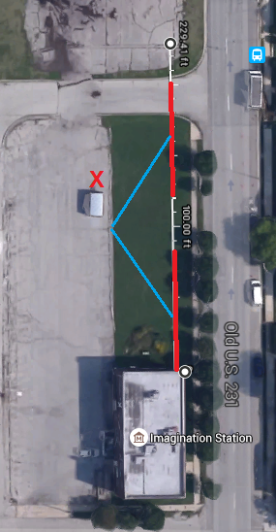
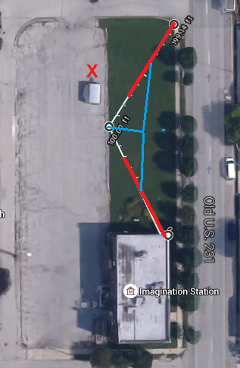
Antennas
For HF, we will use the club’s DX-CC Antennas in one of the configurations shown, depending on the supports available.
The red “X” marks the location of the mast supporting the 6M Moxon and 6/2/70 Triband Vertical antennas for the VHF station.

Slide 9
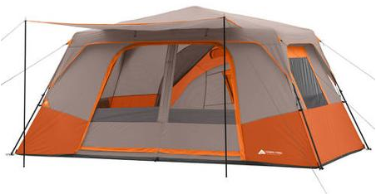
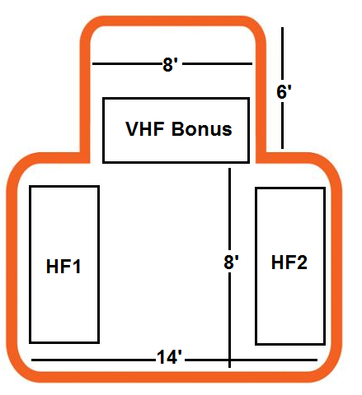
Shelter
HF Phone Station:
KC9SWV – Icom IC-7300
HF CW Station:
K9JWI – Elecraft K2
VHF Bonus Station
KD9EWM – Yaesu FT-991

Slide 10
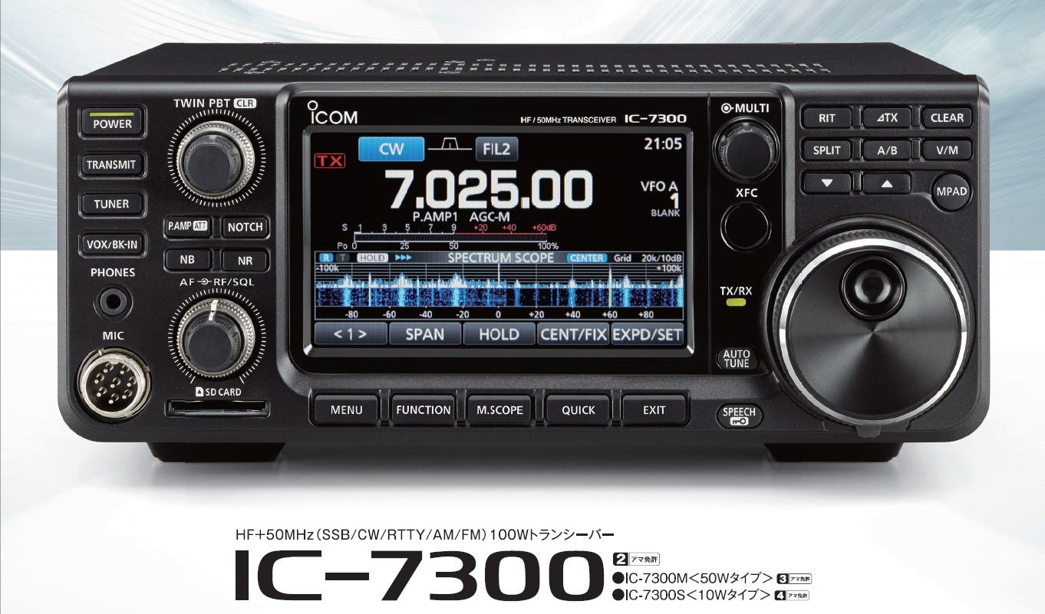
HF1 – Phone Station
New Icom IC-7300 direct sampling 160-6 Meter transceiver.
Windows 7 Laptop
Transceiver integrated with N1MM software for automatic frequency/mode data in log.

Slide 11
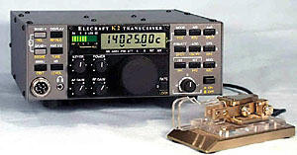
HF2 – cw station
Elecraft K2/100 80-10 meter transceiver.
Windows Laptop.
Radio integrated with N1MM for automatic frequency/mode in log.

Slide 12
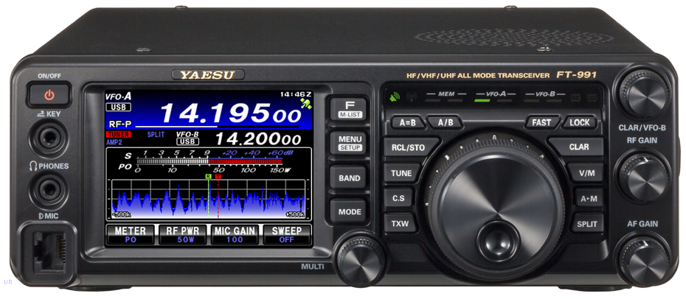
Vhf bonus station
Yaesu FT-991 160m-70cm touchscreen transceiver with band scope.
Windows Laptop.
Transceiver integrated with N1MM software for automatic frequency/mode data in log.

Slide 13
On the air
What should I say and hear?

Slide 14
Typical field day exchange
Station Calling CQ
Station searching & pouncing
CQ Field Day, CQ Field Day, this is Whiskey 1 Sierra, W1S, calling CQ Field Day and standing by.
KC9SWV, please copy 2 Alpha, India November.
1 Delta India November, QSL. Thanks and good luck. QRZ?
Kilo Charlie Niner Sierra Whiskey Victor.
2 Alpha India November, QSL. Please copy 1 Delta India November.

Slide 15
Calling cq
CQ Field Day, CQ Field Day, this is Whiskey 1 Sierra, W1S, calling CQ Field Day and standing by.
When calling CQ, it’s a good idea to say “CQ Field Day”. While Field Day is HUGE and 90% of stations on the air those two days are participating, no one has exclusive use of the bands…make your intentions clear.
Also, it’s a good idea to say your call in both phonetic and standard letters to make sure you’re heard clearly.

Slide 16
Answering a cq
Kilo Charlie Niner Sierra Whiskey Victor.
This is a contest. It’s fast paced and the bands are jam packed. You might not get through on the first call.
Just say your callsign in phonetics one time and wait to see if you were heard.
If the CQ’ing station doesn’t hear anyone clearly enough, they might say “QRZ?” or “Again?” asking everyone to try again.

Slide 17
I didn’t quite hear
Station Ending “Whiskey Victor”
A lot of times in a big pile up, you will only hear one or two letters clearly from a station.
The CQ’ing station might ask for you to repeat your call by saying “Station Ending” and the last letter or two of your call.
Just repeat your full call again in phonetics.

Slide 18
First exchange
KC9SWV, please copy 2 Alpha, India November.
Station class
If the station hears you, they will repeat your call telling you that they’re talking to you.
The should give you their station class and ARRL section. These both have to go in the log.
Arrl section

Slide 19
Your reply
2 Alpha India November, QSL. Please copy 1 Delta India November.
Repeat for confirmation
It’s a good idea to repeat back to them what they gave you for Station Class and ARRL Section. If you’re certain you heard correctly, you can skip this and just say “QSL”.
Now, give them our Class and Section.
our arrl section
our station class

Slide 20
Confirmation
1 Delta India November, QSL. Thanks and good luck. Whiskey 1 Sierra, QRZ?
Repeat for confirmation
The CQ’ing station may or may not repeat back what you said. If they have any question, repeat again so they can hear clearly. The bands are packed and conversations overlap often. You may want to say it twice.
If they end their turn with “QRZ?”, “Field Day”, “CQ”, etc that means they are done and wanting another station to call.
Rarely will a CQ’ing station expect or desire to hear you say “73” afterwards.

Slide 21
Additional exchange notes
Anyone operating from home is a 1D station unless they are operating from emergency power, in which case they are a 1E.
If they don’t know, they’re probably 1D.
Any station not in the US or Canada is logged as 1D for class and “DX” for their section.

Slide 22
Station classes
Class A – Club/Non-Club Portable
Class AB – Club/Non-Club Portable Battery
Class B – One or Two Person Portable
Class BB – One or Two Person Portable Batt.
Class C – Mobile
Class D – Home Stations
Class E – Home Stations (Emergency Power)
Class F – Emergency Ops. Centers
The following station classes are valid for logging.
Most of the stations logged in 2015 were Class A.
Second most popular was Class D.

Slide 23
The software
N1What?

Slide 24
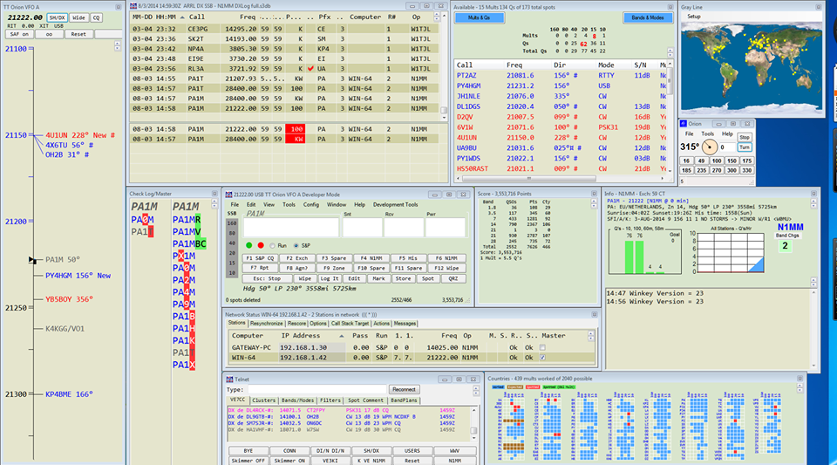
N1mm logging
Because it is the best software for logging during a contest, TARA uses N1MM Logger for Field Day.
It allows rapid logging of pertinent contest information, automatic synchronization among stations, and automatic scoring and report generation.

Slide 25
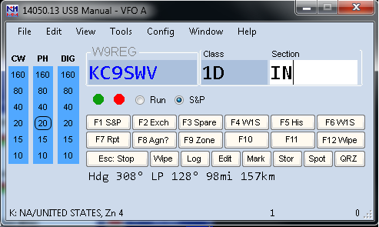
Don’t worry!
It looks complicated, but it’s not so bad if you break down what’s happening with all those windows.
They each have a purpose and you don’t have to use any of them except one to actually use the software.

Slide 26
The Entry window
This is the bread and butter of the whole operation (after the initial setup is complete).
You simply enter the Callsign, Class, and Section of the station you contacted, then click “Log”.
TAB or SPACE moves between each box, and hitting ENTER will log the QSO if all the boxes are filled.

Slide 27
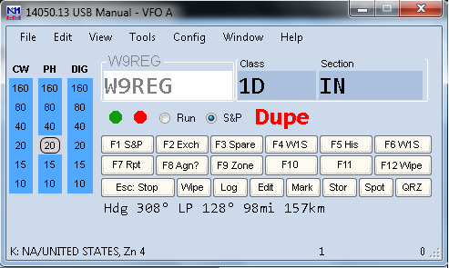
Duplicate checking
Callsign turns blue when it is a properly formatted call. N1MM has no way to check that it’s CORRECT, only that it looks legit.
If you (or someone else) has already worked that station on the band/mode you’re operating, the callsign will turn gray and a warning will show “Dupe”.

Slide 28
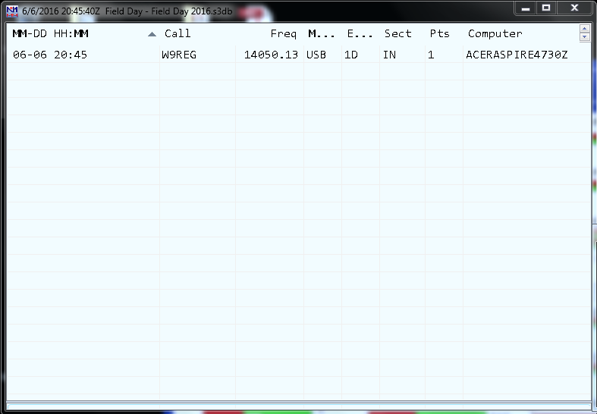
Log window
The Log Window will show all stations worked by anyone on any band, since we are synchronizing over the network.
You can use it just like Excel to sort by clicking on each header to sort by Frequency, Callsign, Time, etc.

Slide 29
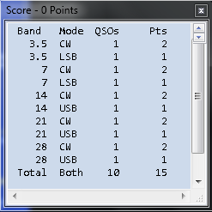
Score window
The Score Window will keep track of the number of QSOs per band/mode made for the entire Field Day operation.
You can see how we’re doing in real time!

Slide 30
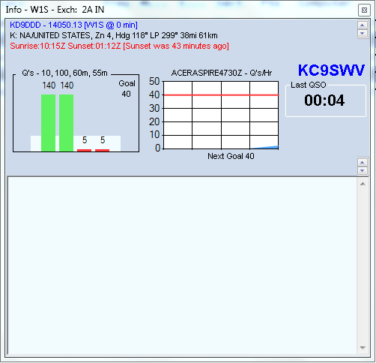
Info window
The Info Window shows the club’s progress towards the goals I set for this year. It tallies all the QSOs you have made and uses the time between each QSO to calculate a projected QSO/hr rate.

Slide 31
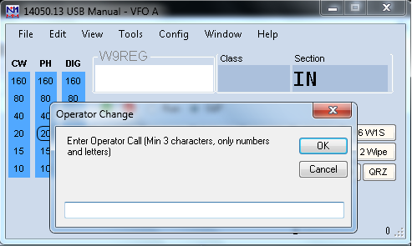
Operator change
When you sit down at a radio as the operator, be sure to log in as such!
Simply press “Ctrl-O” and a window will pop up asking for your Callsign. This will mark all the QSOs you make in the log.
If we meet or exceed my goal of 3,000 points AND 750 actual QSOs, I will buy dinner for the person with the most QSOs (actual QSOs, not points) after Field Day.
Note: Don’t worry, you won’t have to eat dinner with me, I’ll be giving a gift card for a restaurant!

Slide 32
2016 field day goals
Ultra-Realistic Expectations, Amazing Results

Slide 33
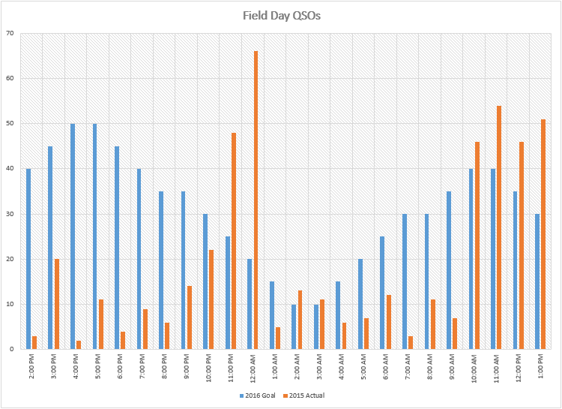
QSO rate
Orange is 2015 Actual.
Blue is 2016 Goal.
What’s going on here? Let’s take a look…

Slide 34
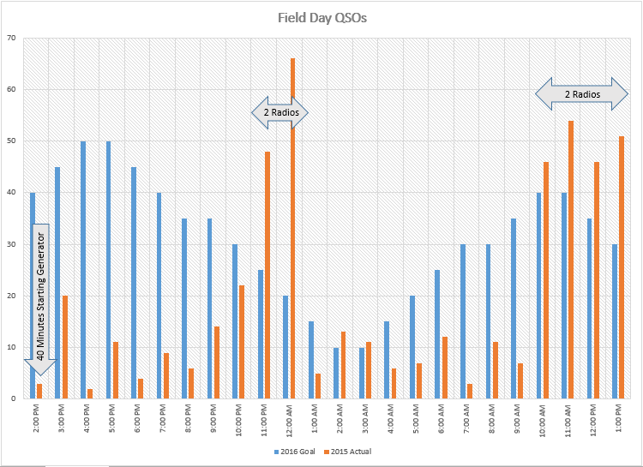
Issues with qso rate
Key 2015 Issues:
Lost 40 minutes of prime operating at begging try to secure and start generator.
Only about (8) hours of (24) were both HF radios in operation.
45-50 QSOs per hour are clearly possible with both HF radios in operation!

Slide 35
Qso goal breakdown
Hour |  | Goal
2:00 PM | 2:59 PM | 40
3:00 PM | 3:59 PM | 45
4:00 PM | 4:59 PM | 50
5:00 PM | 5:59 PM | 50
6:00 PM | 6:59 PM | 45
7:00 PM | 7:59 PM | 40
8:00 PM | 8:59 PM | 35
9:00 PM | 9:59 PM | 35 | Sunset
10:00 PM | 10:59 PM | 30
11:00 PM | 11:59 PM | 25
12:00 AM | 12:59 AM | 20
1:00 AM | 1:59 AM | 15
2:00 AM | 2:59 AM | 10
3:00 AM | 3:59 AM | 10
4:00 AM | 4:59 AM | 15
5:00 AM | 5:59 AM | 20
6:00 AM | 6:59 AM | 25 | Sunrise
7:00 AM | 7:59 AM | 30
8:00 AM | 8:59 AM | 30
9:00 AM | 9:59 AM | 35
10:00 AM | 10:59 AM | 40
11:00 AM | 11:59 AM | 40
12:00 PM | 12:59 PM | 35
1:00 PM | 1:59 PM | 30
To make the target of 750 actual QSOs, we need to average around 30/hour. With peaks of 45-50 and lulls at night of only 10, this would still be possible.
We need operators at both HF radios all day, both days!
VHF contacts can help supplement these if the bands cooperate, but we can’t count on that alone.

Slide 36
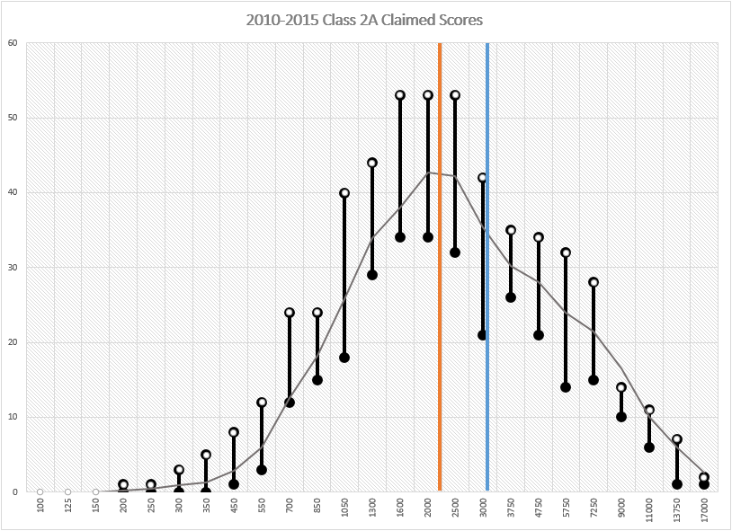
Total score goal
Assuming we can make 750 actual QSOs, we should expect a score of approximately 3,000. Last year, we were just over the hump of the bell curve, but with a below-average score. A score of 3,000 would put us just above average!
5 Year Average Score = 2,833
TARA is in 42nd Percentile.
Goal is 32nd Percentile.
(Top 1/3 of Clubs)

Slide 37

The big problem
The biggest problem we have isn’t our antennas, our location, our equipment, our knowledge, the food we serve, the weather, our shelter, our organization, or our ability.
Our biggest problem is that we’re scoring ourselves as a 2A station, but spending most of our time operating 1A.
We need people to come
out and operate a radio!
We Need You!
(To Run a Radio)

Slide 38
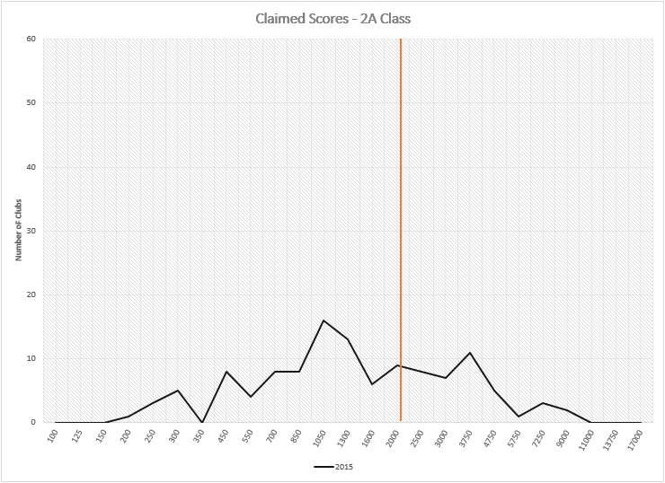
If we were 1a
Had our score from last year been asserted as a 1A club instead of 2A we would have been in the 28th Percentile.
(Yeah, we would have had a slightly lower score because we couldn’t claim some of the bonuses.)

