Slide 1
Amateur Antennas
Theory, design, and fabrication

Slide 2
What is an Antenna?
An electronic device that is used either for radiating electromagnetic energy into space or for collecting electromagnetic energy for space
Any wire carrying AC current will radiate electromagnetic waves and an electromagnetic wave will induce a voltage in a length of wire

Slide 3


the basics
Ripples in a pond
Ripples on a pond
The waves radiate out from where the water was struck
The algae on the pond only bobs up and down
The water is only moving up and down.
The part that raises the algae is called the crest
The part that lowers the algae is called the trough
The waves take a certain amount of time to travel across the pond
  The velocity of the wave can be calculated by:
  $$Velocity=\frac{distance traveled}{required to travel the distance}$$
  OR
  $$v=\frac{d}{t}$$

Slide 4
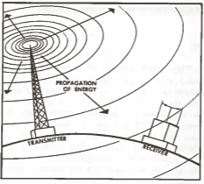

The Basics
Waves in Space
Electromagnetic waves are similar to the waves on the pond
When the radio waves encounters something that it can act on it gives some of its energy to that device
The velocity can also be measured and calculated
Instead of total distance we measure from one crest to the next waves’ crest—the wavelength
  Measured in meters
  The Greek letter lambda $λ$
  SO: $V=\frac{λ}{T}$

Slide 5

The Basics
Waves in Space
The number of complete waves every second is the frequency
The frequency is therefore the reciprocal of the period $T=\frac{1}{f}$
So, $V=\frac{λ}{\frac{1}{f}}$ OR $V=fλ$
V is a constant at 300,000,000 meters per second also known as the speed of light

Slide 6

The Basics why do we care
The equation $V=fλ$ can be rearranged to determine frequency and meters, or band.
This is needed to construct a dipole.

Slide 7
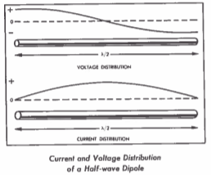
The Dipole
The key to a dipole is the endpoints.
The voltage standing wave is high at the endpoints and low at the center whereas the current is low at the endpoints and high in the center.
The important thing to note is that the current and voltage peak ¼ wave off of each other.

Slide 8
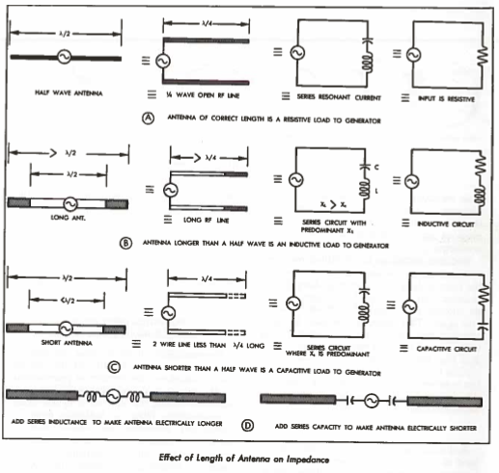
Impedance and capacitance
An antenna of the correct length presents pure resistance to the source Line A
A longer than ½ wave presents an inductive load to the source Line B
A shorter than ½ wave presents a capacitive load to the source Line C

Slide 9
Time to Design and build!
Questions:
  What does the antenna need to do?
  Is this for a permanent installation, mobile, or portable?
  Do I need just one frequency or multiple?
  What are the space constraints?
  Where is it going to be installed?
  Aesthetic requirements

Slide 10
“Imitate until you can innovate”
-Kevin Smith
Has someone built an antenna that will work for your needs?
Is there a guide that can walk you through the build?
  RSGB Stealth Antennas
  RSGB HF Antennas for Everyone
  ARRL Antenna Book
  ARRL Basic Antennas
  ARRL Wire Antenna Classics
  And many others
Look around at what fellow hams have in the area
Pictures on QRZ or the internet in general.

Slide 11
Design
Whether you are designing your own from a blank page, following instructions from the ARRL Antenna Book, or duplicating a picture that you saw somewhere, start by drawing a diagram.
It doesn’t have to be to scale
It doesn’t have to use technically accurate symbols
Its purpose is to help you understand what you are setting out to do.

Slide 12
Parts
Key Factors
  What components do you have access to?
  What tools are at your disposal?
  What fabrication techniques are you comfortable with?

Slide 13
Helpful Tools
PVC cutters
Miter saw
Drill press
Torch and solder
Wire strippers
Drill (Cordless or corded)
Drill Press
Multimeter
Antenna analyzer

Slide 14
Components
The plumbing section is your friend.
Copper pipe makes for great antennas.
PVC is a fantastic form for coils.
The strange looks from the Menard’s plumbing department when you tell them that you’re building an antenna are priceless!
Stick to copper, brass, aluminum, and stainless steel for hardware and radiators.
  Steel has a high internal resistance that is less than ideal.

Slide 15
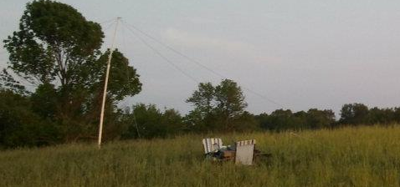
The inverted V
Simplest of my antennas
It’s a ½ wave dipole supported in the center with the other ends anchored near the ground.
The radiation pattern is Near Vertical. Which is why it is a Near Vertical Incident Skywave (NVIS) antenna
These are good for communication with “nearby” stations.
Mine is used for Indiana QSO Party (INQP) and Indiana State Parks on the Air (ISPOTA)
Furthest contact on mine was near Rome, Italy on 40 meters.

Slide 16
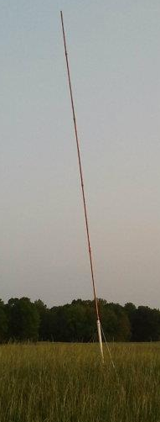
Monopole
Nearly as simple as the Inverted V
¾ copper pipe cut into 4 foot sections with various length end pieces to allow it to be a ¼ wave on 40-10 meter bands (1 band at a time)
A portable ground plane was constructed from toilet ring repair gaskets and tape measures
Used mostly for INQP and INSPOTA due to high takeoff angles.

Slide 17
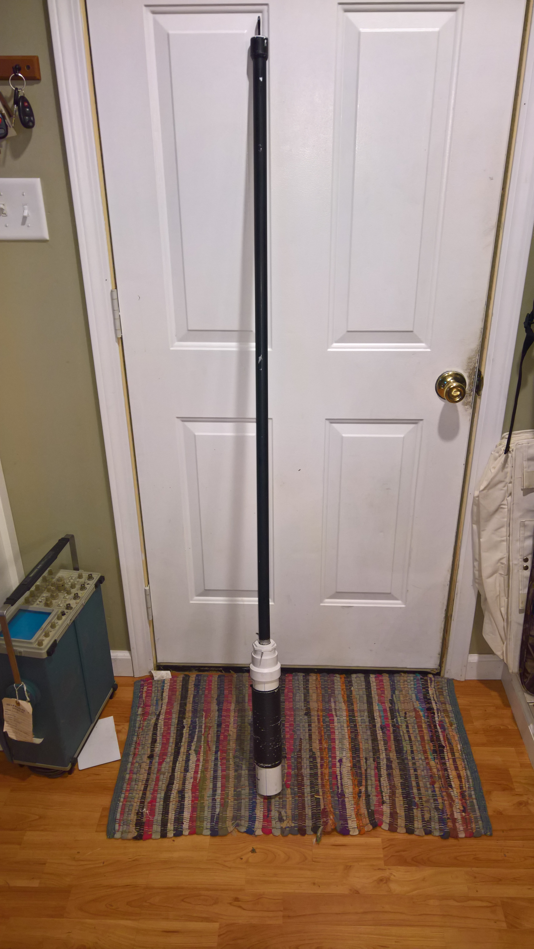

Micro-Vert
Components
  Capacitive Radiator
    Length (mm) calculated by $l_{s}=\frac{4700}{f}$
    Capacitance calculated by $C_{pF}=19.1∗ l_{s}∗\frac{1}{\log{0.575 }∗\left(\frac{l_{s}}{d}\right)}$
  Reactance Coil (Loading Coil)
    Inductive reactance to compensate for the capacitive reactance
    Inductance calculated by $L_{μH}=\frac{{\left(\frac{159}{f}\right)}^{2}}{C_{pF}}$
    More on that in a minute
  Counterpoise
    Acts as the “ground plane” for the antenna
    Uses the antenna feed line in conjunction with an RF choke balun
    Length (m) calculated by $l_{r}=\frac{58}{f}$

Slide 18
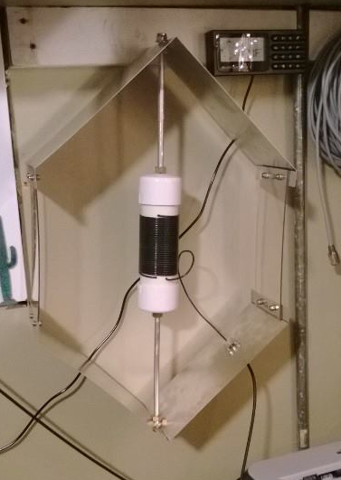
Isotron
Components
  Inductive coil
  Large “Capture Area”
  Large “Capture Area” as a counterpoise
How to build it
  Copy the commercially produced version
  I’m still working on figuring out the math
  According to isotronantennas.com
    For an antenna to work, it should be electrically resonant. The ISOTRONS are electrically resonant by using only two components - the large coil in series with the capacitive plates of the antennas. (Match comes automatically with the right combination of the two components at resonance). There is more that is necessary for an efficient antenna. An antenna needs a certain amount of area to couple radiation to the atmosphere. Some call this the "Capture Area". However, this is an "AREA". This "area" can be any shape or form. The laws of physics for this phenomenon do not specify its appearance. THE ISOTRONS HAVE THIS RADIATION "AREA". The ISOTRONS exceed or equal (depending upon the model) the area of a conventional one-half wavelength dipole (#12 wire). In simple terms, we designed the ISOTRONS into a three dimensional package.

Slide 19
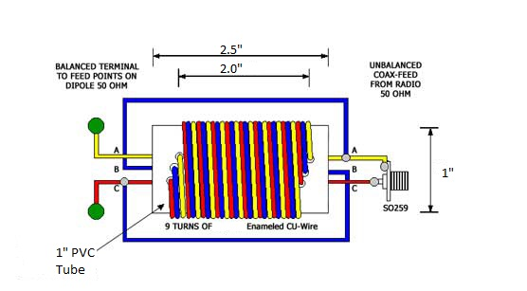
Baluns
Purpose
  To connect a balanced antenna to an unbalanced line
1:1 Choke Balun
  Not actually a Balun
  Purpose is to eliminate RF currents from flowing on the outside of the coax
  Presents a high impedence to the RF on the outside of the coax
  Forces the current on each side of the coax to be equal
  Simplest is the “ugly balun
    ~21feet of coax coiled around a form
    Size of form doesn’t matter
  The 1:1 Balun that I use is to the right.

Slide 20
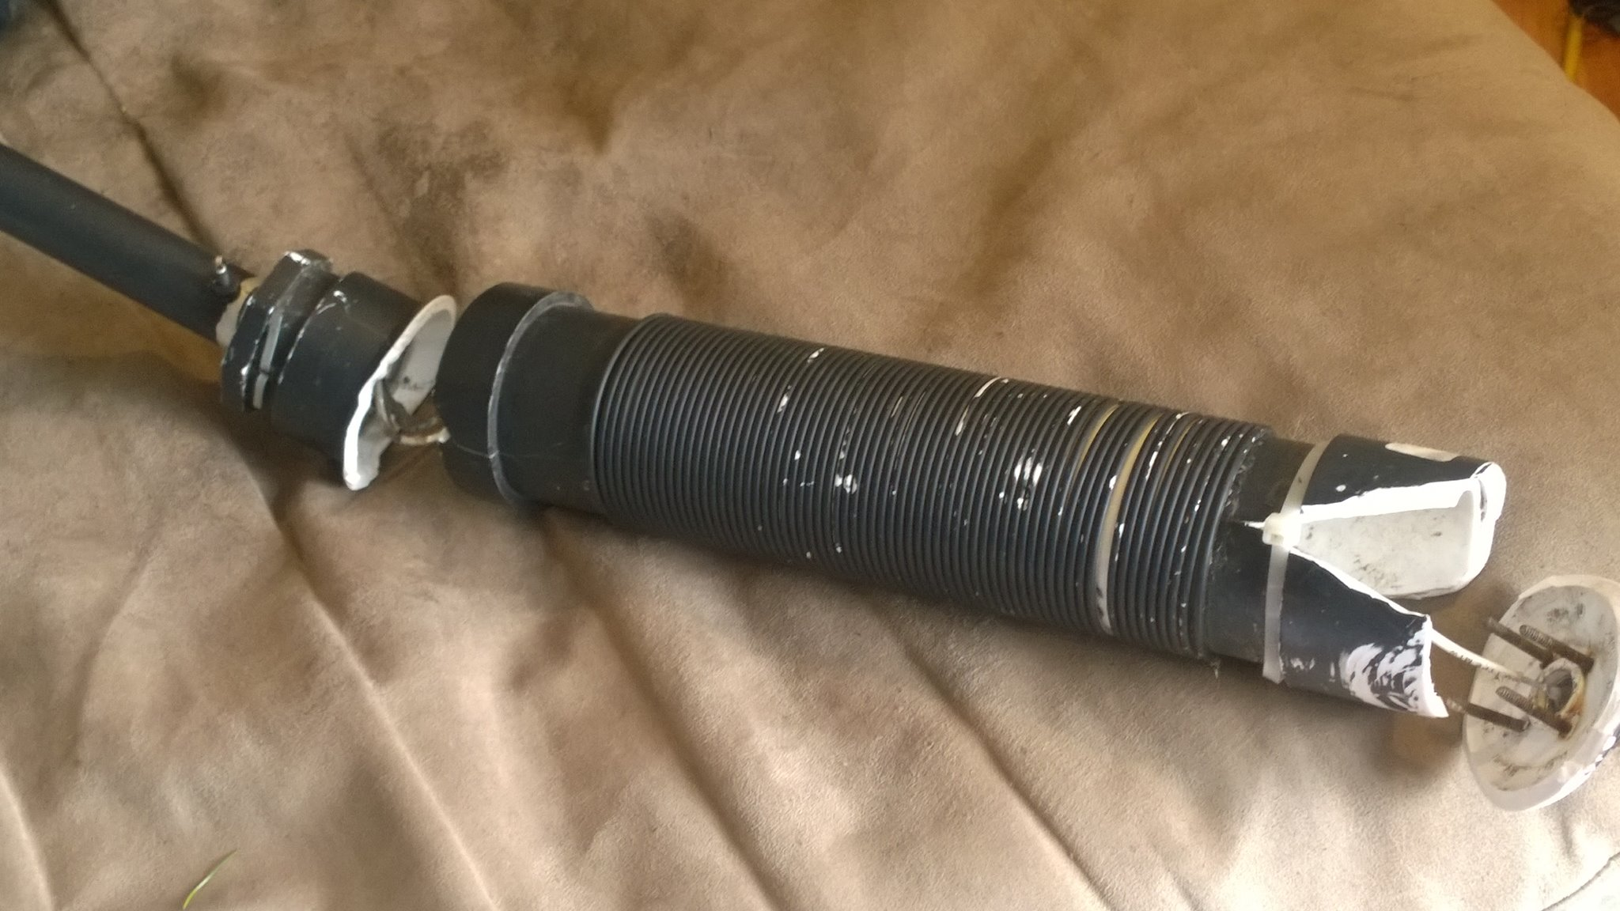
Be mindful of the elements!

Slide 21
References
Straw, R. D. (ed.). (2009). The ARRL antenna book (21st ed.). Newington, CT: ARRL.
ARRL. (1974). The ARRL antenna book (13th ed.). Newington, CT: ARRL.
Myers, R. (ed.). (1975). The radio amateurs handbook (52nd ed.). Newington, CT: ARRL.
Hallas, J. R. (2009). Basic antennas: Understanding practical antennas and design. Newington, CT: ARRL.
Ford, S. (ed.). (2014). ARRL’s even more wire antenna classics (vol. 3). Newington, CT: ARRL.
Silver, H. W., Wilson, M. J. (eds.). (2010). The ARRL handbook (87th ed.). Newington, CT: ARRL.
Dennison, M., Fielding, J. (eds.). (2011). Radio communication handbook (11th ed.). Bedford, UK: Radio Society of Great Britain.
Read, G. (ed.). (2010) . HF antennas for everyone. Bedford, UK: Radio Society of Great Britain.
Nichols, S. (2010). Stealth antennas. Bedford, UK: Radio Society of Great Britain.
US Air Force. (1963). Fundamentals of electronics. Washington, DC: US Government Printing Office.
Bilal Company. (n.d.). How do the isotrons work? Retrieved from https://isotronantennas.com/index.php?main_page=page&id=3.
Schaefer, J. (2001) Progress in design of extremely short transmitting antennas. AnteneX: Retreived from http://download.antennex.com/preview/archive4/Apr601/microvert.pdf

