Slide 1
Notes:
With today’s advanced electronic technology, low cost and low power ham stations
Can be assembled.
This is an introduction to the world of low transmit power (QRP) High Frequency (HF)

Slide 2
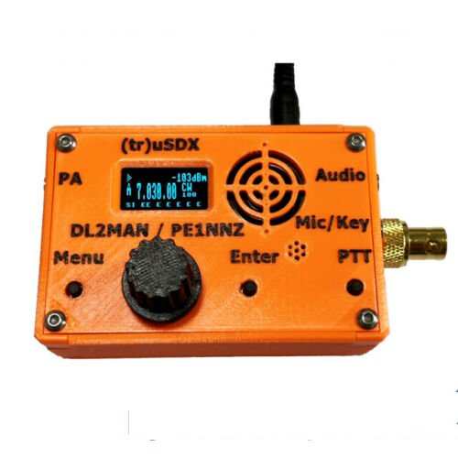
Your Low-Cost HF Station
Notes:
With today’s advanced electronic technology, low cost and low power ham stations
Can be assembled.
This is an introduction to the world of low transmit power (QRP) High Frequency (HF)

Slide 3
Decisions, decisions, decisions
Kit or Fully Assembled
New or Used
CW, Phone, or Digital
QRP (low power) or Full Power
Single or multi-band

Slide 4
New or Used
Used Kit – why is it even on the market, does it work?
Used Prebuilt – Setup and Tuned

Slide 5
Make or Buy?
Kits are not always the cheapest – required tools:
  Soldering iron and Solder
  Hand tools (clippers, desoldering device, long-nose)
  Water saturated sponge or pad
  Test equipment for tuning (signal generator, signal analyzer)
  Practice and patience
  Work area and Time
  Time

Slide 6
CW, Phone, or Digital
Continuous Wave (CW): Morris Code requires a key and code skill
Low power transmitter and sensitive receiver can reach long distances
Phone requires a microphone and transmit key
Requires most transmit power and receiver sensitivity for long distances.
Digital requires an interface and a PC with sound card or laptop.
Allows for receiving very weak signals and a low power transmitter
Mode is your choice, depending on interest and skill

Slide 7
Make or Buy
Pre-built – More expensive?
Plug and play
Support
Setup and tuned

Slide 8
Minimum Station Options
Single-band CW Transceiver
Single-band Phone Transceiver
Digital Transceiver
Multi-band Phone Transceiver

Slide 9
Transmitter Power Considerations
QRP: 10 Watts or less.
Low-cost components
Limited range depending upon band conditions
High Power: 1500 Watts legal maximum depending upon band and mode.
High-cost components
Power amplifier required
RF safety considerations
Serious DX operators

Slide 10

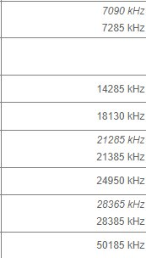
Typical QRP Frequencies
BAND Frequency

Slide 11
Minimum Single-band CW Station Components
Single-band CW Transceiver
Key
Speaker
Power supply
Antenna
Feedline
License
Logbook
Code lessons

Slide 12
Minimum Digital HF Station Components
Digital Transceiver
Laptop or PC
Cables and Software
Speaker
Power supply
Antenna
Feedline
License
Logbook

Slide 13
Minimum Single-band Phone HF Station
Single-band Phone (Single Side Band –SSB) Transceiver
Microphone
Speaker
Power supply
Antenna
Feedline
License
Logbook

Slide 14
Minimum Multi-band HF Station Components
Single Sideband Transceiver
Microphone
Speaker
Power supply
Antenna
Feedline
License
Logbook

Slide 15
Some Low-Cost Antenna
Long wire between trees
Sloping wire antenna from one tree

Slide 16
Lowest Cost Multi-band Phone Station
Kit Low Power (QRP) Transceiver
Kit Antenna tuner
Untuned long wire antenna
9:1 Balun
12-volt Brick Power Supply
Earphone, mic and Push To Talk (PTT) switch

Slide 17
Example 1: (tr)uSDX Transceiver Kit: $96.00
Assembled:
$148.00

Slide 18
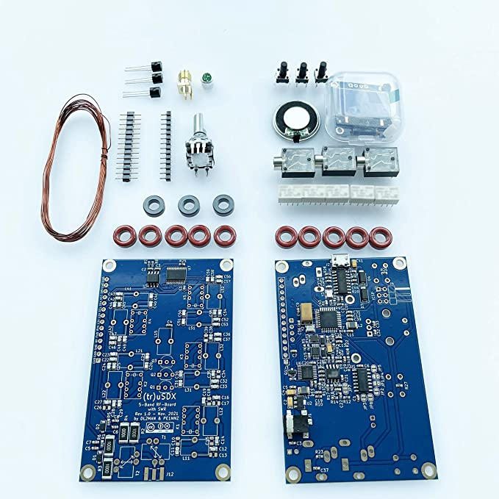
(tr)uSDX Kit
Two PC boards
IC chips installed
DIY Tasks
Wind Toroids
Install “lead-ed” components
Encase
Tune and test

Slide 19
(tr)uSDX Transceiver disclaimer
You usually get what you pay for
Reliability
Quality
Mixed reviews
Chinese version has bad reputation
Production quantities are low – extended delivery

Slide 20
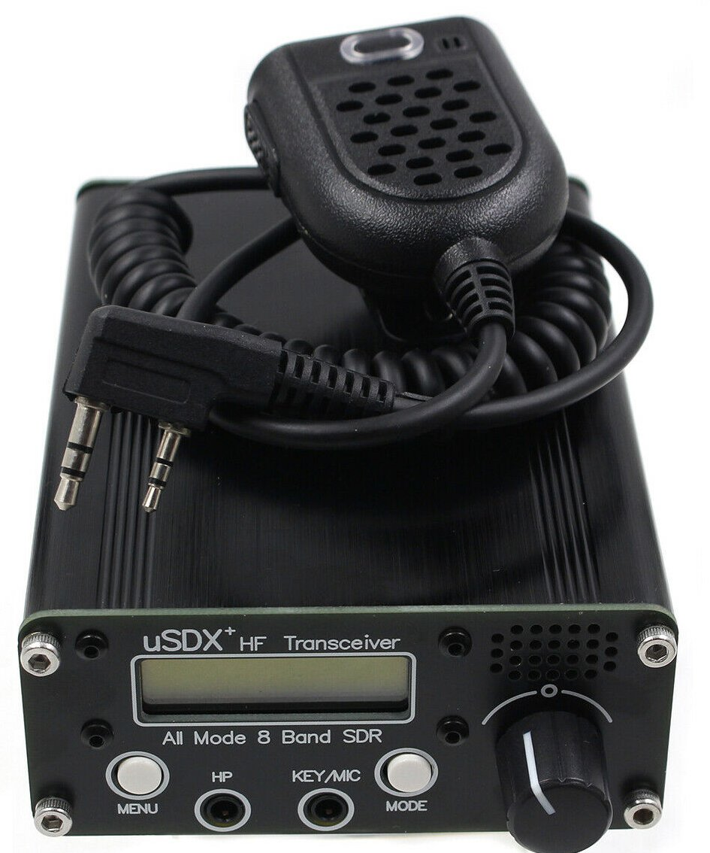
Example 2: uSDX+ v2 8 BAND ALL MODE HF TRANSCEIVER
$144.00

Slide 21
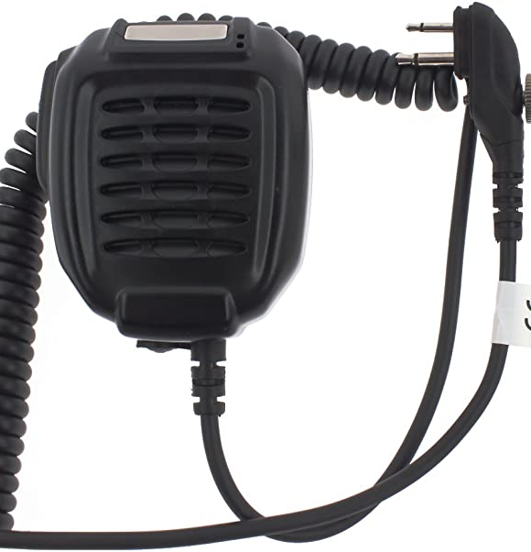
Example: Speaker, mic w/ Push to Talk (PTT)

Slide 22
Software Defined Radio
Based on today’s fast processors
Inexpensive due to Arduino and Raspberry Pie micro processor
Feature rich due to bigger, multi-core processors and memory
Updates and refinements are possible due to NVRAM technology
Implementation due to Digital Signal Processing technology
Software modulation, demodulation and decoding

Slide 23
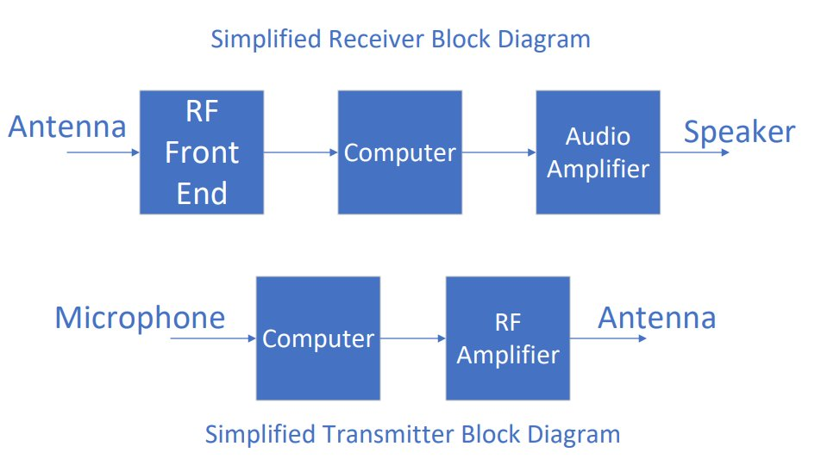

Slide 24
Example: Long Wire Antenna
Insulated wire strung between two tall objects on your property
  Keep away from power lines over property and to house
  Hang between two insulators connected to rope, fixed at one end and run thru pully at other end to weight hanging above ground
  Feed wire at fixed end with a 9:1 Balun
  Best if ¼ wavelength of lowest band
    i.e., 65.6 feet for 80 meter band

Slide 25
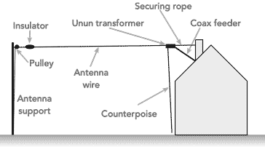
Example: Simple Long-Wire Antenna

Slide 26
Example: Long Wire Antenna
  Provide lightning protection – best is to disconnect antenna and ground when not in use. Don’t use during thunderstorm.
  Use 50-ohm feed line between Balun and transmitter, the shorter lowest lost the better.
  SAFETY FIRST during installation and use. Keep as high as possible and above 15 feet minimum. Use lowest transmit power that gets contacts.

Slide 27
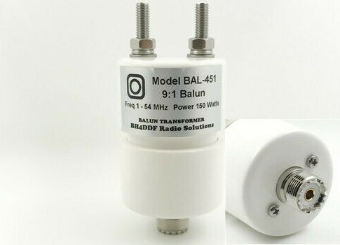
Example: 9:1 150 watt Balum $20

Slide 28
Tuning a long-wire antenna
Random length antenna no likely to have resonance in ham bands
For maximum signal radiation, transmitter must be matched to antenna
If not matched, RF power will be reflected back into transceiver and not fed into antenna. Transceiver damage could occur.
QRP antenna tuners are available in kit and pre-built form

Slide 29
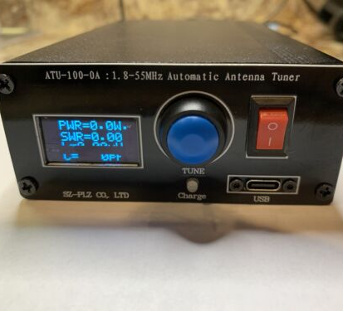
Example: ATU Automatic Antenna Tuner $55

Slide 30
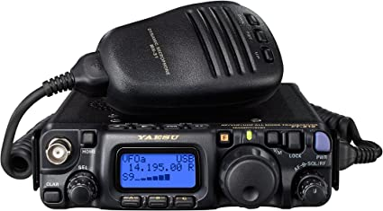
Alternative to low-cost transceiver
Yaesu FT-818ND 6W HF/VHF/UHF All Mode Mobile Transceiver $730

Slide 31
Disclaimer
Beware of product quality. Some Chinese models are junk!
Do your research before buying, lots of information on Web
Keep an eye open for FCC certifications and warning.
This presentation the result of Web research, not experience.

Slide 32
Conclusion
All the examples are cheap, foreign-made kits with DYI assembly.
QRP means less than 5 watts of transmitter power.
A properly tuned antenna as high as possible, a low loss feed line and patience is essential.
QRP and DYI means challenges and new skills.
For approximately $350 you can have a complete HF station.

Slide 33
Fini

