Slide 1
Resonant vs Non-Resonant Antennas: Getting on the Air with What You Have
TARA February 2026
Alan Schwab - WO9G
Notes:
I’ll cover how antennas work, what resonant really means, and why high impedance ladder line plus a tuner is often a great solution for real-world stations

Slide 2
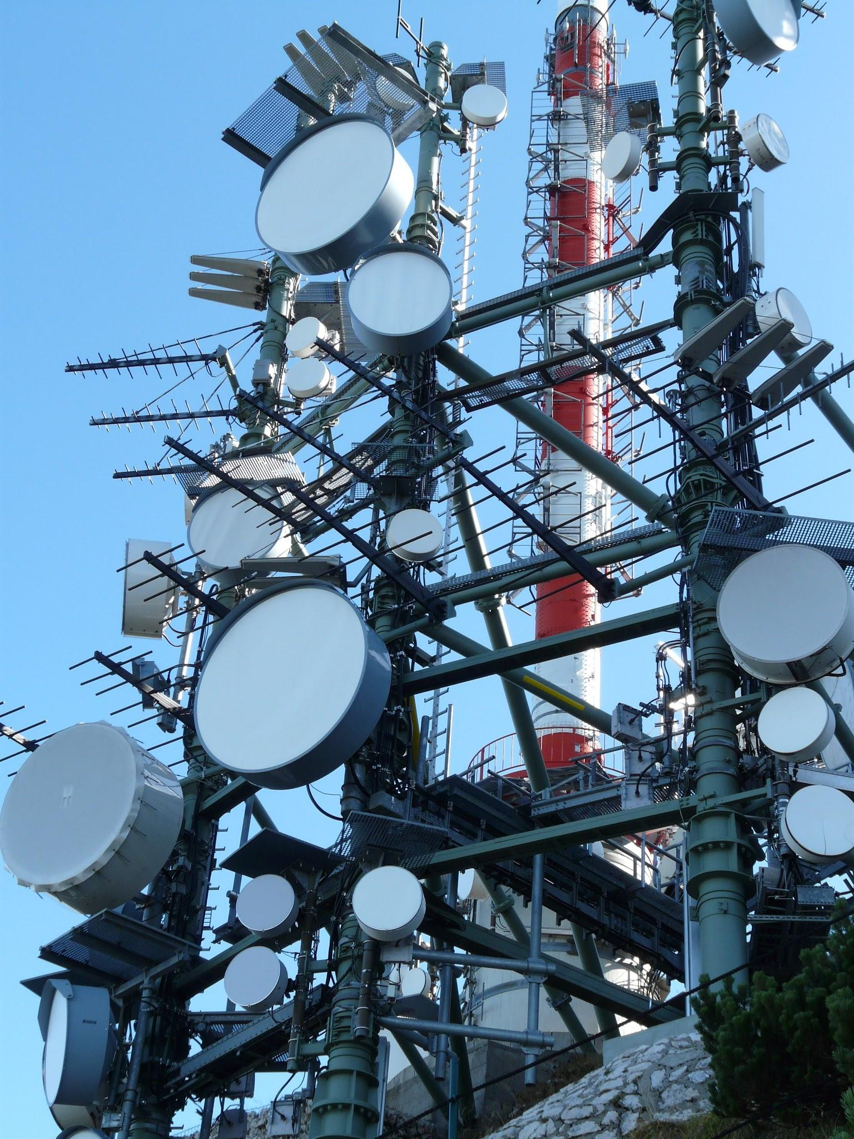
What an Antenna Really Does
Antenna is the link from your radio to free space
On Transmit: Radio Frequency (RF) current in the element creates changing electric and magnetic fields that leave the antenna as a radio wave
On Receive: Those fields push electrons in the element, creating RF voltage and current that your radio can amplify.
Antennas are reciprocal: What works well on transmit usually works well on receive
Notes:
It’s just metal that lets RF into and out of free space

Slide 3
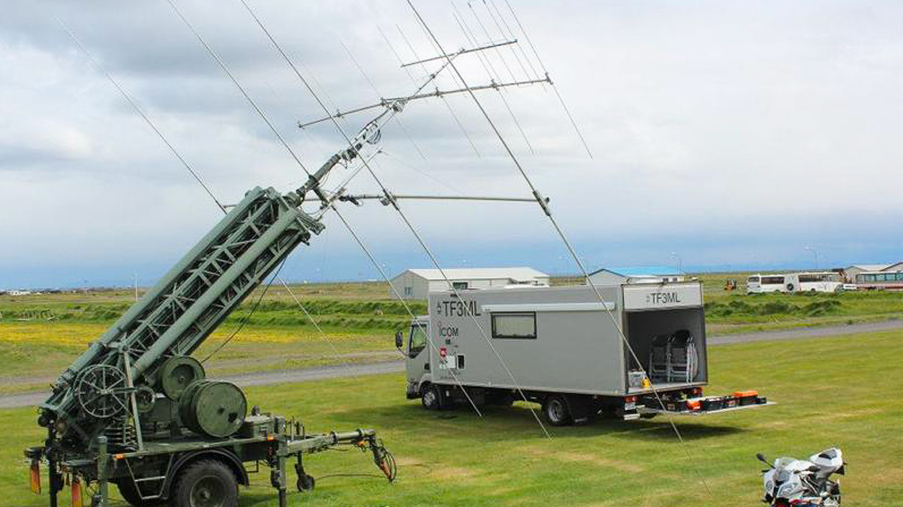
Wavelength and Size
For efficient radiation, antenna dimensions are a significant fraction of a wavelength
Common examples are the half-wavelength dipole, quarter wave vertical, or ⅝ wave vertical
Long wavelength radio frequency mean a physically larger antenna for the same fraction of a wavelength
This is why 80m (75m or 80m actually) and 160m antennas are so physically challenging for small yards. And now 630m band which is nearly a half mile long

Slide 4
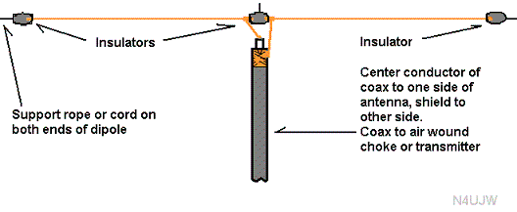
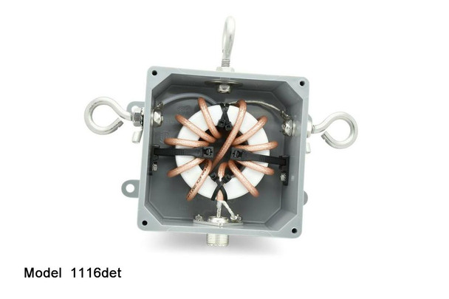
The Half-Wave Dipole
It’s the simplest practical antenna: a straight conductor about a half wavelength long
Fed in the center so that each leg is a quarter wavelength
Classic pattern is broadside to the wire
At resonance, the feedpoint impedance is mostly resistive and near the range we like for easy matching
Notes:
Mention over real ground and height and surroundings will tweak the impedance and pattern. Use a good quality 1:1 isolation balun at the center feed point to isolate coax from the antenna.

Slide 5
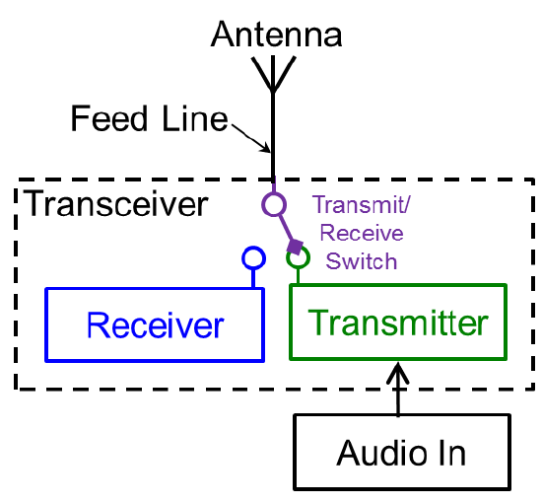
Basic Antenna System Block
Radio -> Feedline -> Antenna
Add a tuner or matching network anywhere in the chain to make impedances play nicely
On HF feedlines are usually coax, ladder line, or open wire line
An Antenna system is just Feedline and Antenna working together
Notes:
Set up that we care about the whole system, not one point’s SWR

Slide 6
What “Resonant Antenna” means
An antenna is resonant when it’s input reactance is near zero at a given frequency
At that frequency it looks mostly like a pure resistance load
A resonant antenna with the right resistance is easy to match to 50 ohm gear
A half wave dipole is usually near 50-75 ohm at resonance
Notes:
Reactance isn’t used up as heat it is stored as a field and can be returned to the circuit

Slide 7
Why We Love Resonant Antennas
Easy to feed with 50 ohm coax
Low SWR at the radio without a tuner
Predictable performance across a modest bandwidth
Great for:
  Single-band/monoband radios
  Contest or POTA setups optimized for one band

Slide 8
The Catch: Bandwidth and Size
The cost of these is paid for with their narrow bandwidth. SWR rises as you tune from the design frequency
On low bands a resonant half wave can be very long and not cover the whole band
Resonant multiband designs using traps or fans add complexity and introduce loss or interactions between fans
Many real stations have limited space, height, and budget
Notes:
How many of us here have the lot space to put up a full size 80 meter dipole at 60 feet or more?

Slide 9
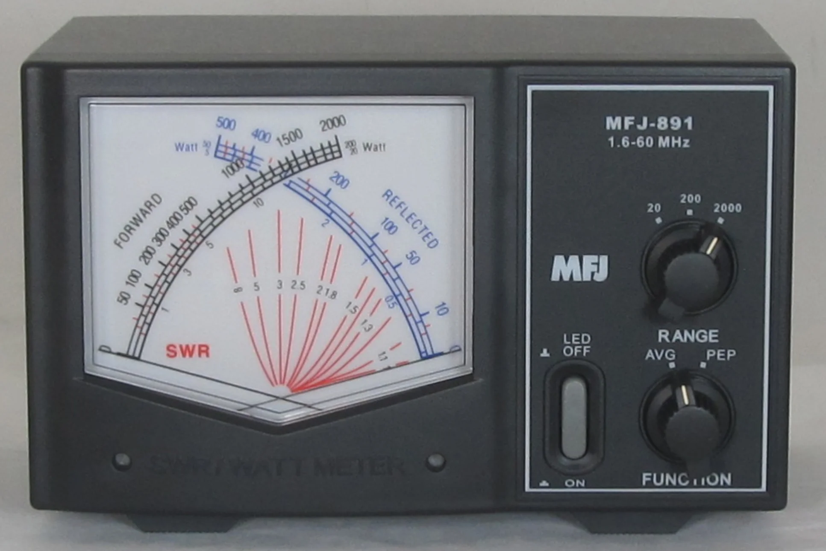
SWR: What it is (and isn’t)
Standing Wave Ratio (SWR) is a measure of mismatch between load impedance and line impedance
A perfect 1:1 SWR means no reflected power on the line at that frequency
High SWR means more reflected power on that line, not necessarily a “bad antenna”
Low SWR at the rig does not guarantee efficient radiation if you burned power up in a lossy, mismatched feedline
Notes:
SWR is local to the line being measured, NOT the antenna system as a whole

Slide 10
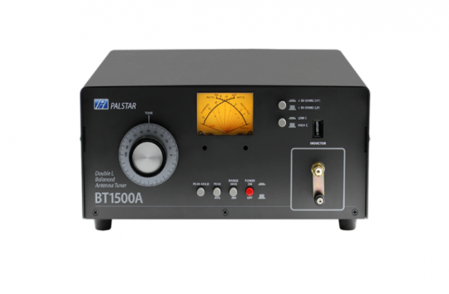
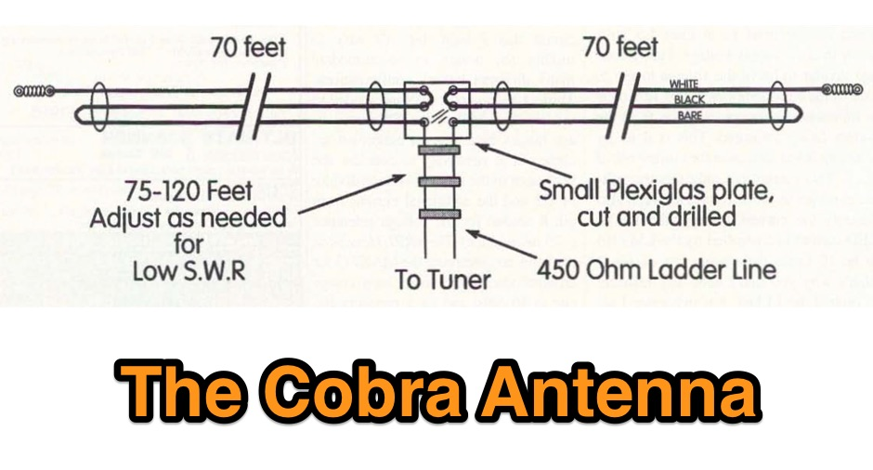
Non-Resonant Antennas
A non-resonant wire just means its impedance is not purely resistive at the frequency of interest
It might still radiate very efficiently as long as current flows
The tuner/matching network can cancel reactance and transform resistance
With the right feedline and tuner, one non-resonant wire can cover many HF bands

Slide 11
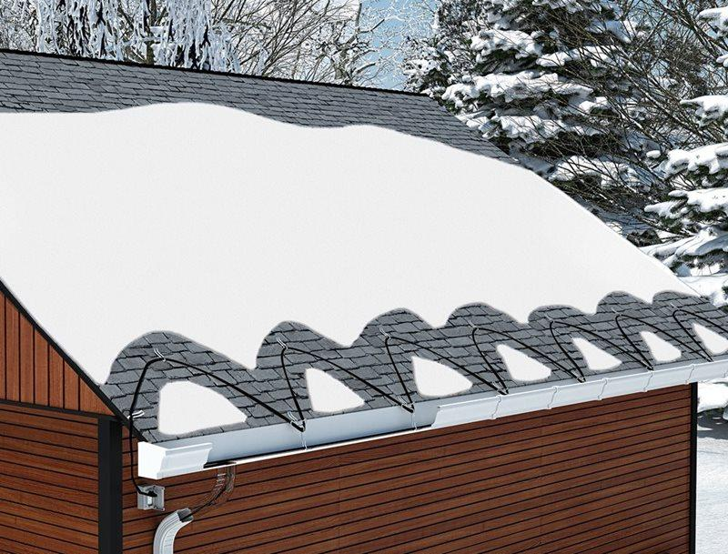
Think in Terms of the Whole System
Antenna system = Wire + Feedline + Tuner + Ground/Counterpoise + Radio
Goal is to present a safe, acceptable load to the radio and send as much RF as possible into space
You can choose where you pay for mismatch
  Heat as lossy coax at high SWR
  In matching components like a tuner or network plus low-loss line
The second option often wins for multiband HF

Slide 12
Why Coax Struggles with High SWR
Coaxial cable has higher loss per foot compared to open wire or ladder line at HF
When SWR is high on coax, voltage and current peaks will increase loss and heating of the coax
Long runs of small diameter coax with high SWR can waste a lot of potentially radiated RF power as heat
That can make a good antenna look bad at the radio or even a bad antenna look good at the radio
Notes:
If you have a great antenna but fed with 100 feet of poor coax you will see great readings at the radio but you will hear nothing as the signals are all gone and yours are all heat

Slide 13
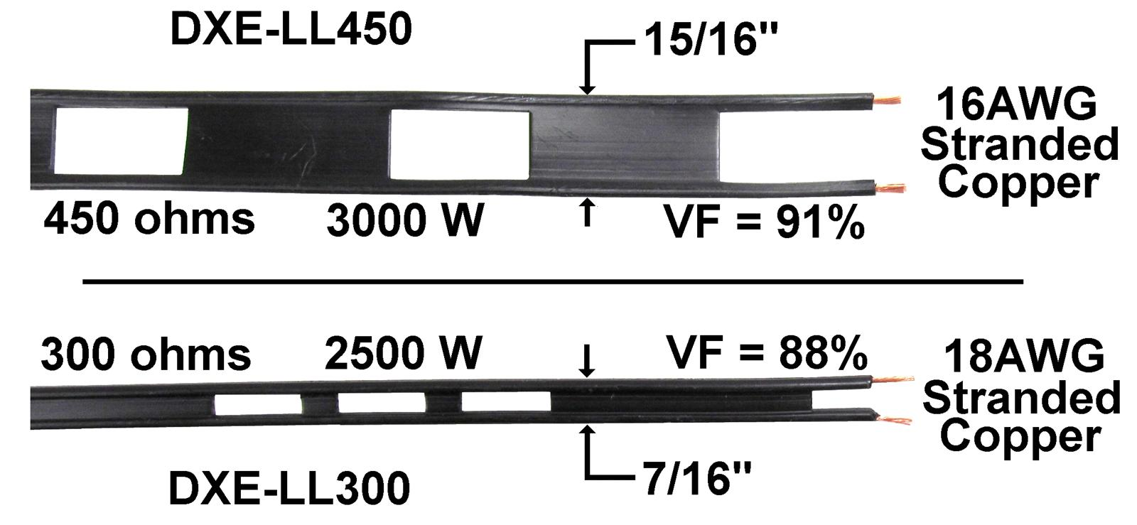
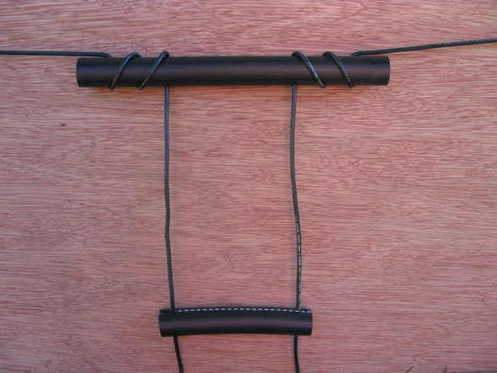
Entering the party: Ladder line / Open Wire Line
Twin lead/Ladder line/Open wire line (300,450,600 ohm) has very low loss at HF compared to typical coax
It tolerates high SWR with minimal additional loss
Higher characteristic impedance means lower currents for a given power, reducing resistive loss
Common values are 300, 450, 600 ohm
Notes:
You can see the spacing between the wires, that determines the characteristic impedance of the line

Slide 14
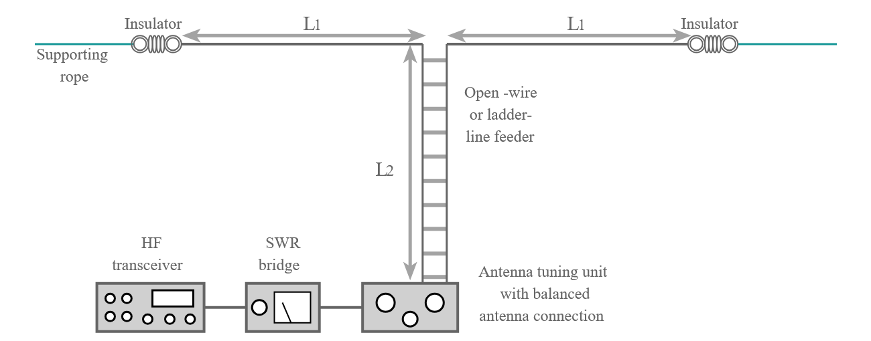
The Non-Resonant Doublet Concept
Take a length of wire, often 80-135 feet total, fed in the center
Use 450 or 600 ohm ladder line from the center feed point to the shack
Use a tuner and often a balun, to match whatever impedance appears at the shack back to a 50 ohm load
Result: One antenna that can cover multiple bands
  Often 80m to 10m including WARC
  This sets apart from using harmonics to cover 40/20/10

Slide 15
Ugly SWR on the Line but Still a Happy Radio
Impedance along the ladder line may vary with frequency
SWR on the line may be 5:1, 10:1, or more - and it’s fine with low-loss ladder or open wire line
The tuner cares only about the impedance it sees at the antenna input
As long as the tuner can transform or match that to 50 ohm then the radio will see 1:1 SWR and is happy
Notes:
Pay attention to where the SWR meter is, it’s telling us how well the match is between the tuner and the antenna is for a given frequency

Slide 16
Why This Works So Well in Practice
Ladder line + Tuner lets you
  Use one wire on many bands
  Get good efficiency even with high SWR on the line
  Adapt to awkward lengths and layouts that are dictated by your property limits
Performance can rival or beat a resonant, single band dipole on many bands especially if the coax runs are long
Copper wire was invented by two hams fighting over a penny
  Use it to our advantage because many power levels we run can be done with 18/20/22 gauge wire

Slide 17
How an Antenna Tuner Really Works
Your transmitter wants to see and 50 ohm, non-reactive load at the output
A mismatched antenna/feedline presents some other complex impedance (R ± jX)
The tuner is a reactive matching network (L/C) that transforms the impedance to 50 ohms at the radio port
In an ideal tuner, the reactive parts store and release energy but do not dissipate it as heat
Reflected power from the mismatch is “re-reflected” back towards the antenna and added in-phase to the new forward power
Result is the radio sees a good match, runs full power, and most of that power is forced out into the antenna system, not burned up in the tuner
Notes:
Losses in the feedline or poor antenna are still there. It can’t fix that, only improves matching. As the power is re reflected, the delay is added by nano seconds, the voice modulation is in milliseconds it’s basically just the equivalence of adding feedline length

Slide 18
Tuner and Balun Considerations
Ideal is a true balanced tuner that directly feeds your ladder line
Common practice however, is a current balun that transforms ladder line to coax
Place the balun on the balanced side of the tuners output if possible
  Reference your manual, many tuners have 4:1 current baluns already on there but some don’t
For many doublets a 1:1 current balun is a good starting point but a 4:1 current can help depending on the impedances
  Use an antenna analyzer and perform a full sweep on the bands intended to be used
https://www.balundesigns.com/doublets/
Notes:
Consult balundesigns.com

Slide 19
Practical Station Recipe
Antenna: 88 to 135 feet total, center-fed (not offset), as high as you can
Feedline: 450 ohm ladder line from the center to the shack bulkhead
At the shack
  Ladder line to a 1:1 current balun https://www.balundesigns.com/model-1151-1-1-atu-current-balun-1-54-mhz-2kw/
  Balun to a manual tuner or auto tuner
  Tuner to 1:1 choke balun https://www.balundesigns.com/copy-of-model-1110-qrp-1-1-isolation-choke-balun-1-5-54-mhz-300-watts/
Bands: Commonly used 80/60/40/30/20/17/15/12/10/6
Notes:
Depending on overall length and tuner you can get on a lot of HF bands

Slide 20
Choices in a Real Yard
Single-band resonant dipole + 1:1 current balun + coax
  Pros: simple, efficient, no tuner needed on that band
  Cons: mostly only one band, space/height demands on lower bands is excessive
Trap or fan dipole + 1:1 current balun + coax
  Pros: multiband with one feedline, often no tuner for bands built for
  Cons: more complex, traps add loss, interactions between elements, still big
Non-Resonant doublet + open wire line + 1:1 current balun + tuner
  Pros: wide band coverage, extremely low feedline loss, flexible layout
  Cons: needs a tuner and usually a balun, can be trickier to route line and manage RFI

Slide 21
Practical Tips and Gotchas!
Keep ladder line away from metal gutters, siding, and long parallel runs of other wiring when possible
Avoid running ladder line flat on the ground or tightly against walls
Expect trial and error for; Wire length, ladder line length, tuner settings
Check for RF in the shack. Hot mic or chassis, RF burns, devices acting up and address with chokes on the power cord or re-adjust the shack setup
Notes:
Changing feedline length can dramatically change the tuner settings. Avoid harmonics of bands

Slide 22
Safety and Power Handling
High SWR along the line can create high voltage and current points
Use components (baluns, tuners, insulators) rated for your power plus a safety margin
Keep high RF areas out of reach of people and pets and pests
Be cautious near trees, metal roofs, and power lines; follow all safety rules and codes
Notes:
If you’re not sure, stop, and re-think the layout

Slide 23
Key Takeaways
Antennas are just devices that couple RF energy between your radio and space. Resonance is one useful condition, not a requirement
A low SWR at the rig is about matching, not automatically about radiation efficiency
Non-Resonant doublets fed with 450 or 600 ohm line plus a tuner are powerful, flexible tools for real-world stations (yours!)
Use the whole antenna system to your advantage: wire length, feedline type, and matching network all work together

Slide 24
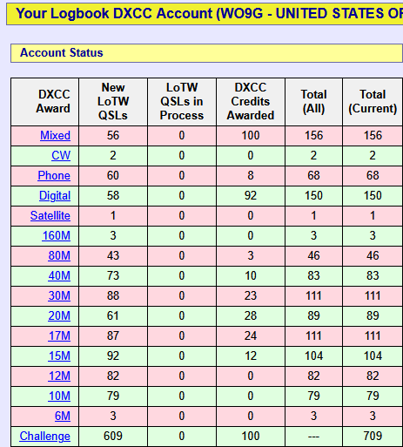
Questions/Discussion/Show and Tell
Who runs a non-resonant antenna with a tuner?
Anyone using 450 or 600 ohm wire?
Compromised antenna layout is perfect for POTA

